Slide 1
Applied Natural Language Processing
Dr. Sucharitha Shetty

Slide 2
Table of Contents
Optimizers

Slide 3
Optimizers
In Natural Language Processing (NLP), optimizers are algorithms used to adjust the parameters (weights and biases) of a neural network model to minimize the loss function and improve performance

Slide 4
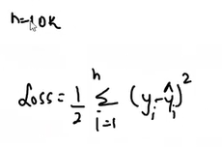
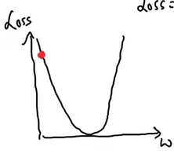
Defn
Epoch – The number of times the algorithm runs on the whole training dataset.
Dataset -10k records, train model for 20 epochs (in every epoch take 10k records do back propagation) –Gradient Descent ( 10k then back propogation then next round again 10k)
What if dataset becomes more than 1 million records- huge RAM, how many weights, convergence will happen slowly

Slide 5

Stochastic Gradient Descent (SGD)
Stochastic Gradient Descent (SGD) instead of all records do one record at a time every front and back propoagation
1 epoch how many iterations for 10k 10 iterations of forward and backward iteration
10k -20 epochs -> 10k*20 iterations- convergence will be very slow

Slide 6
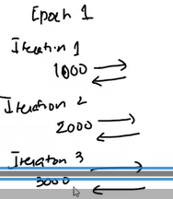
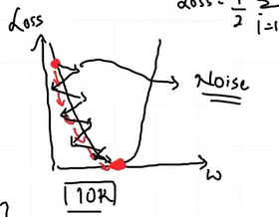
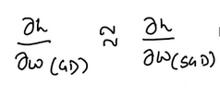
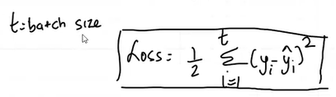
Mini-Batch SGD
20 epochs -10k dataset -1000batch size
Every epoch some batch size then do back propagation
In every epoch 10 iterations means in epoch 1 we can do 10 iterations forward and backward
Noise- it will take time to converge as we are updating batch wise
Less computational expenses

Slide 7
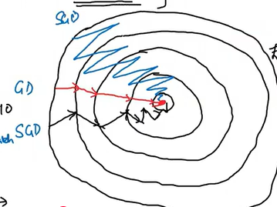
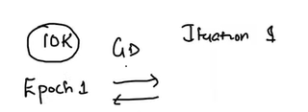
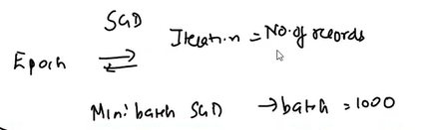

Mini-Batch SGD

Slide 8
Mini-Batch SGD

Slide 9
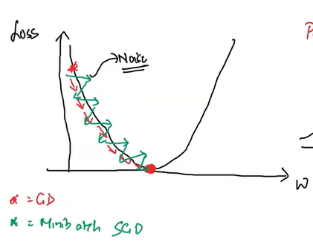
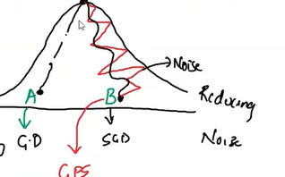

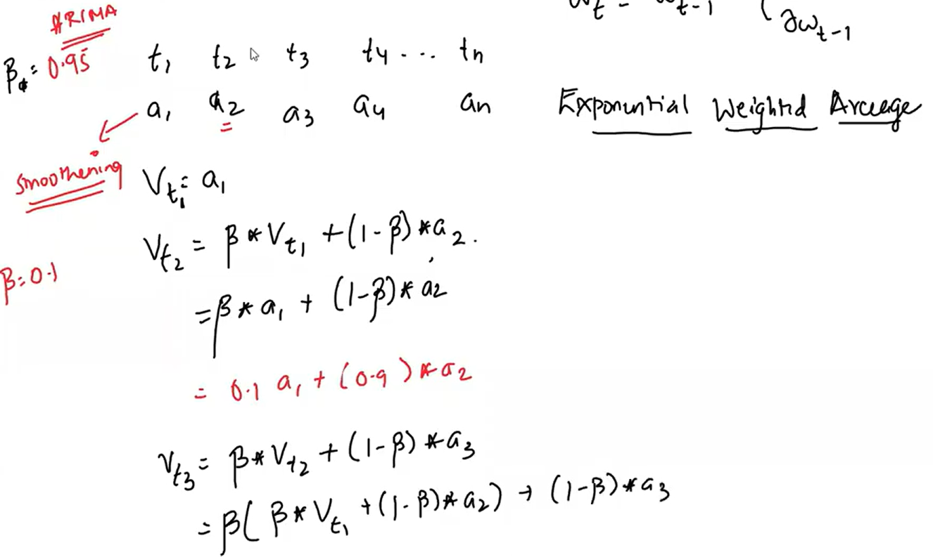
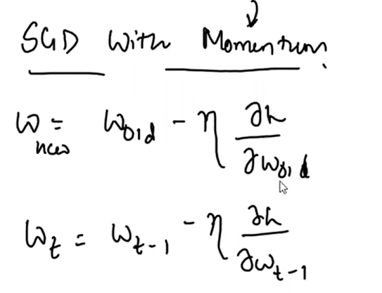
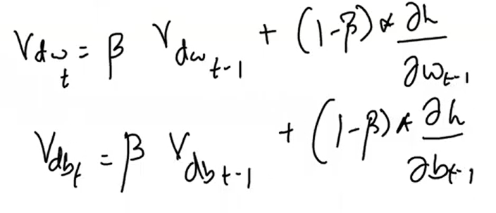
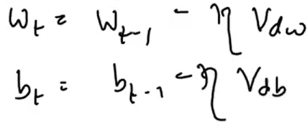
SDG with Momentum

Slide 10
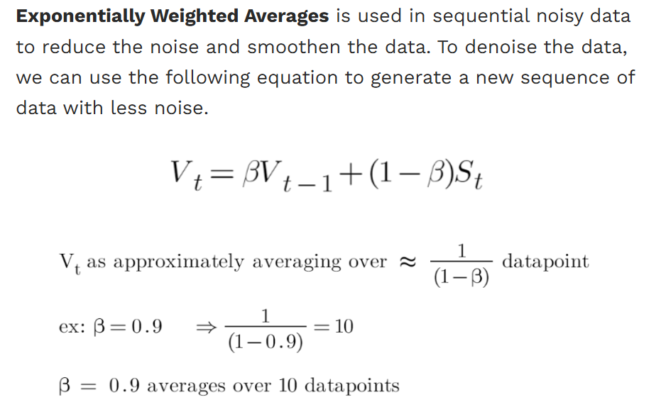

Slide 11
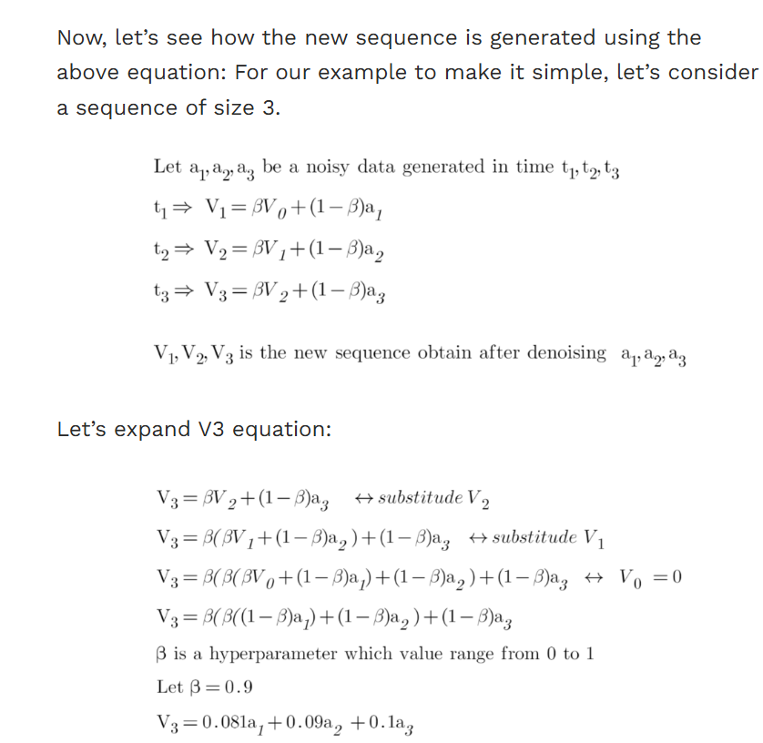
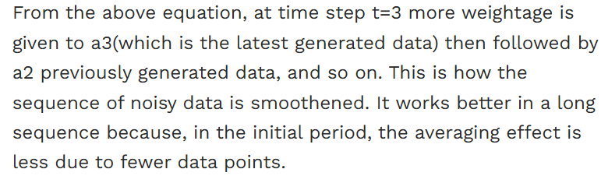

Slide 12
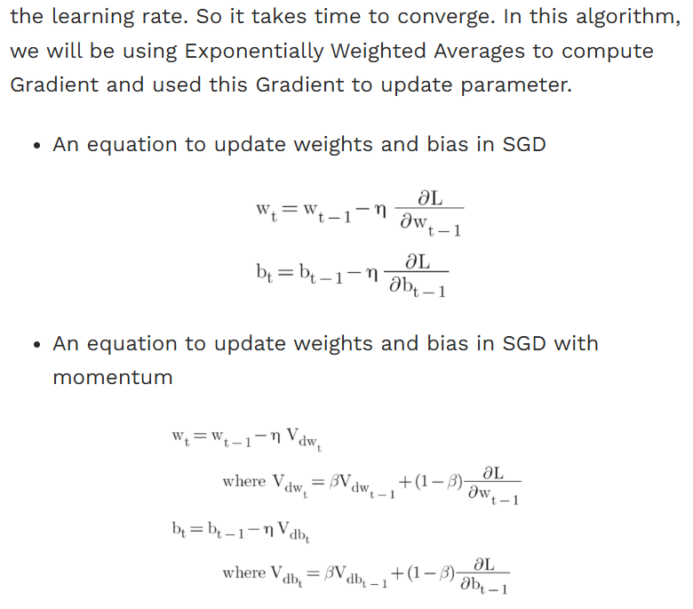
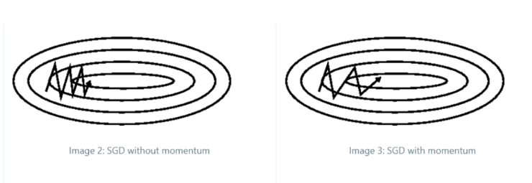
SGD with momentum

Slide 13
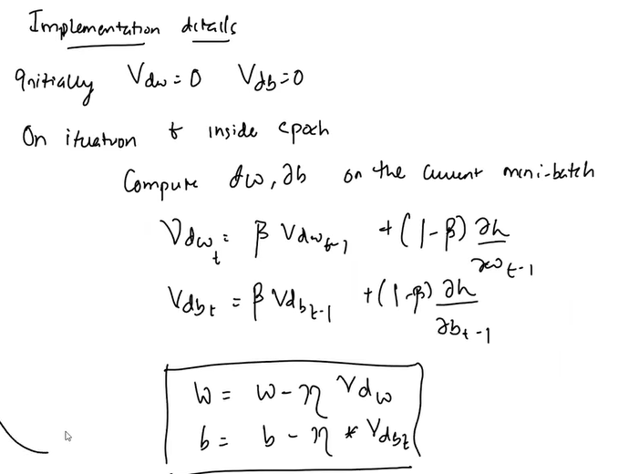
SGD with momentum

Slide 14
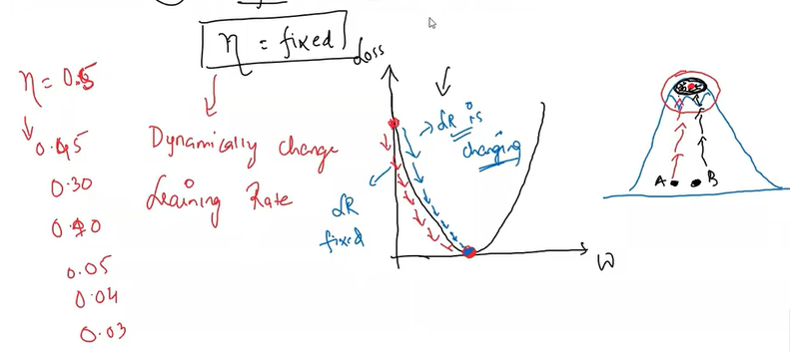
Adagrad: Adaptive Gradient Descent
Learning rate is fixed
If learning rate is fixed stepsize is same
What if as we progress we dynamically change the learning rate

Slide 15
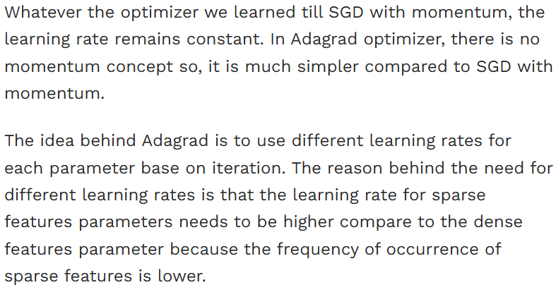
Adagrad (Adaptive Gradient Algorithm)

Slide 16
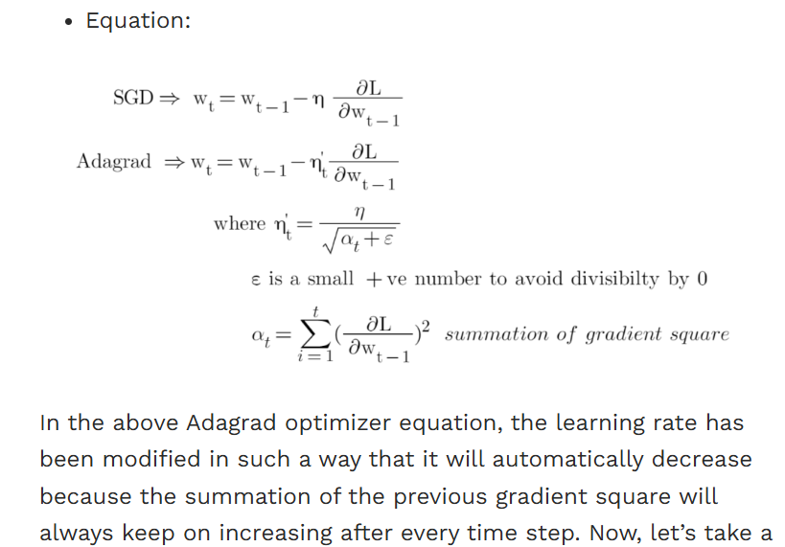
Adagrad (Adaptive Gradient Algorithm)

Slide 17
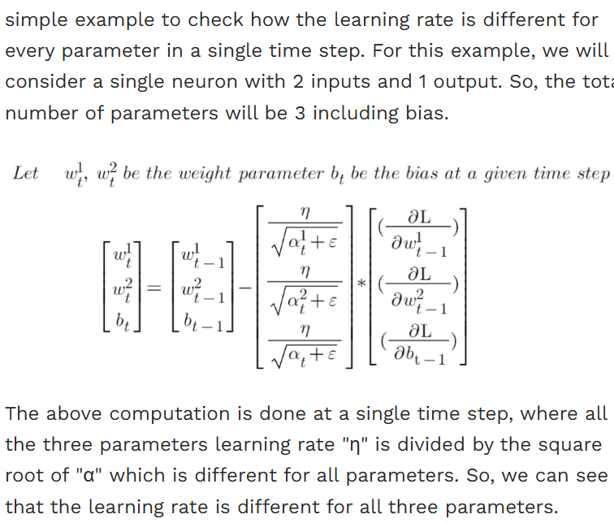
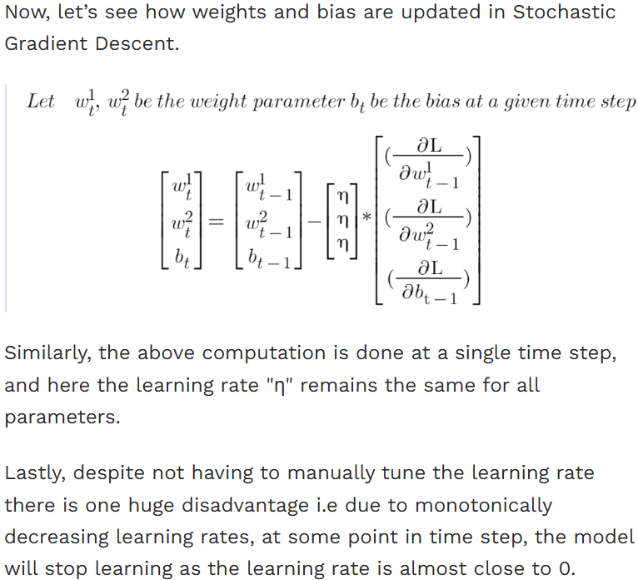
Adagrad (Adaptive Gradient Algorithm)

Slide 18
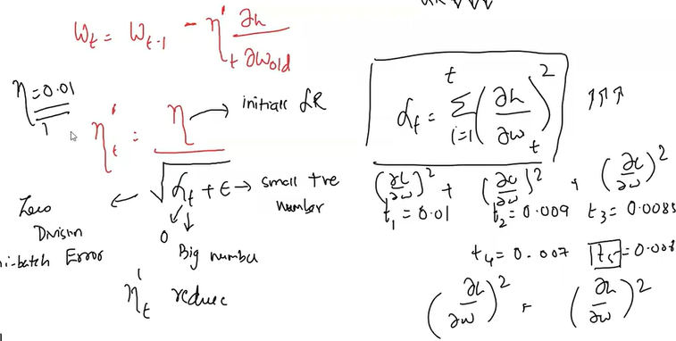

Slide 19
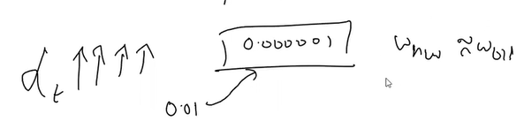
Disadvantage of AdaGrad
Deep Neural network many layers and wts… as we go further the learning rate will be very very small and finally diminish

Slide 20
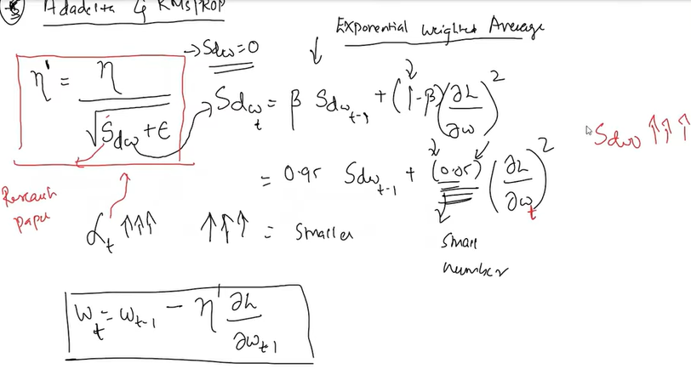
Adadelta

Slide 21
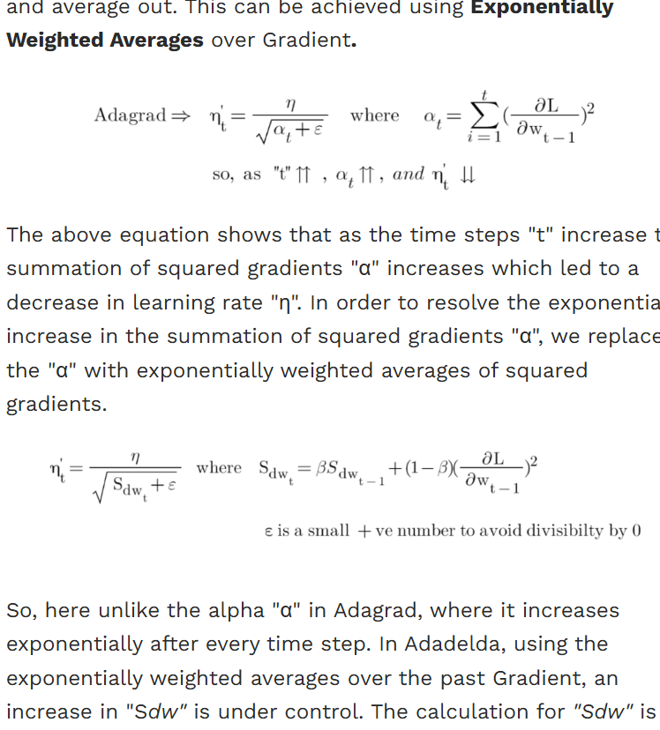
Adadelta
Adadelta is an extension of Adagrad that attempts to solve its radically diminishing learning rates. The idea behind Adadelta is that instead of summing up all the past squared gradients from 1 to "t" time steps, what if we could restrict the window size. For example, computing the squared gradient of the past 10 gradients and average out.

Slide 22
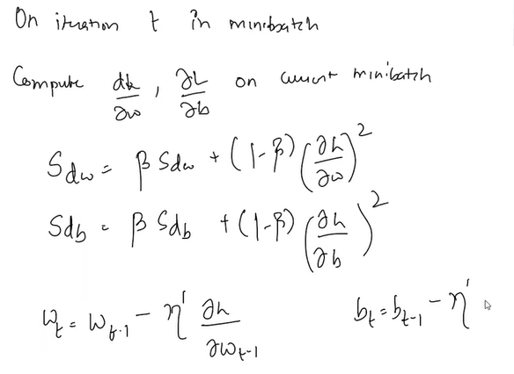
Adadelta

Slide 23
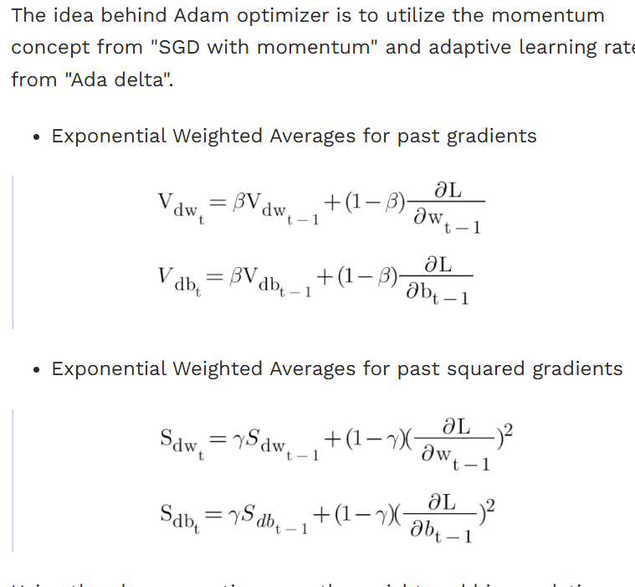
Adam optimizer

Slide 24
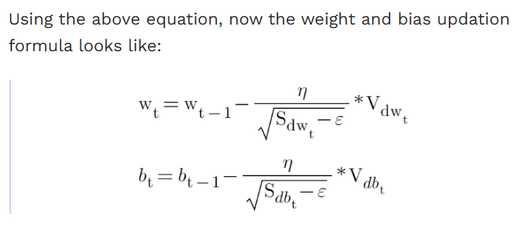
Adam optimizer

Slide 25
Adam optimizer

Slide 26
Thank You

